Slide 1
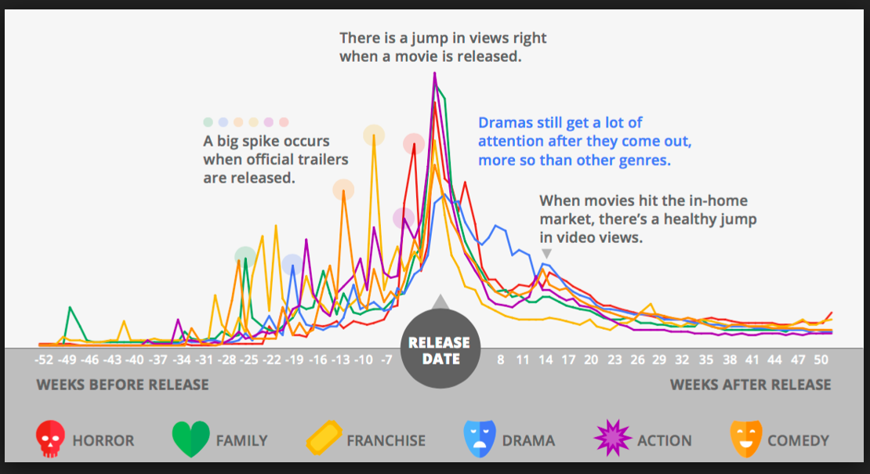

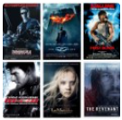
MOVIE ANALYSIS
PRESENTED BY GEOFF, DUSTIN, & APARNA

Slide 2
OVERVIEW
Hypothesis
Question we wanted to Answer
Data Extraction
Data Analysis
Sentiment Analysis
Conclusions
What does it all mean

Slide 3
DATA ANALYSIS
The Movie Analysis Data Science Project aim is to do some basic movie analysis from the datasets. The different aspects of a movie were taken into consideration such as Revenue collected by a Movie, it’s Opening Total, Lead Actors, Director & their Popularity Ratings. In order to visualize the analysis, the different types of graphs were utilized to display the comparisons and calculations.

Slide 4
Hypothesis
If a movie was produced using the highest score attributes: popularity, highest lifetime revenue, and highest opening total within the categories; Actor, Director, and Genre, then a movie with these top categories will make higher Revenue.

Slide 5
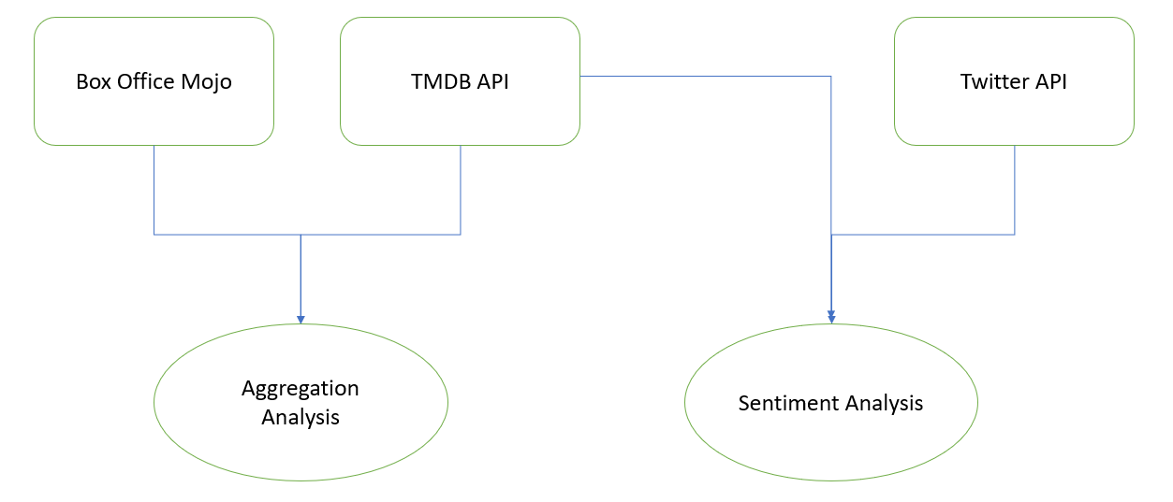
HIGH LEVEL PROCESS
DATA SOURCES/EXTRACTS/APIs

Slide 6
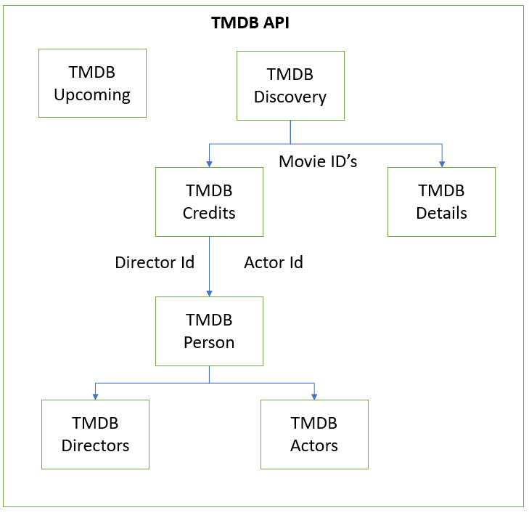
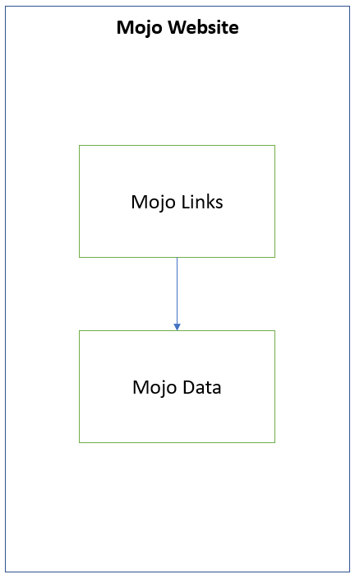
DATASETS
TMDB MOJO

Slide 7
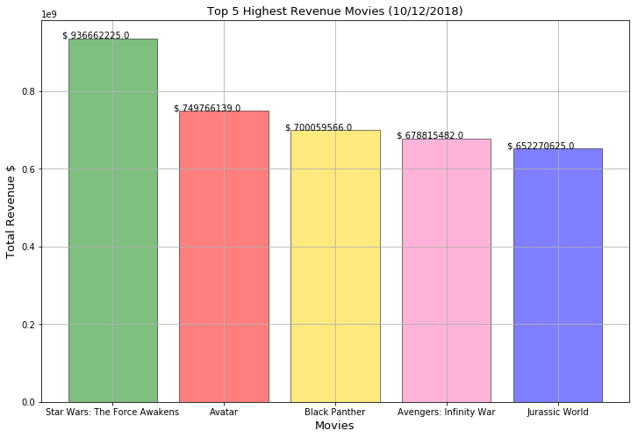
GRAPHS
MOJO DATASET: Graph 1 - Top 5 Highest Revenue Movies

Slide 8
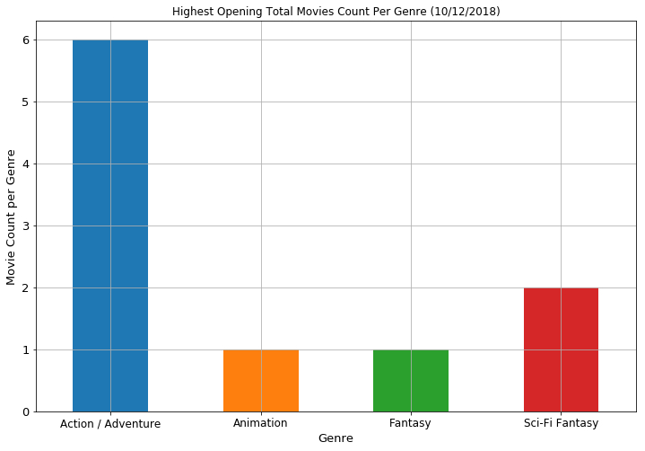
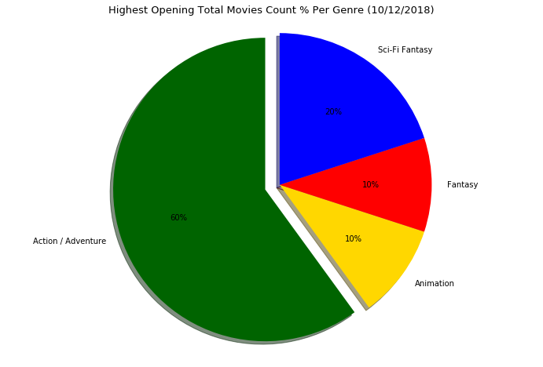
GRAPHS
MOJO DATASET: Graph 2 – Highest Opening Total Movies Count (# vs %) Per Genre

Slide 9
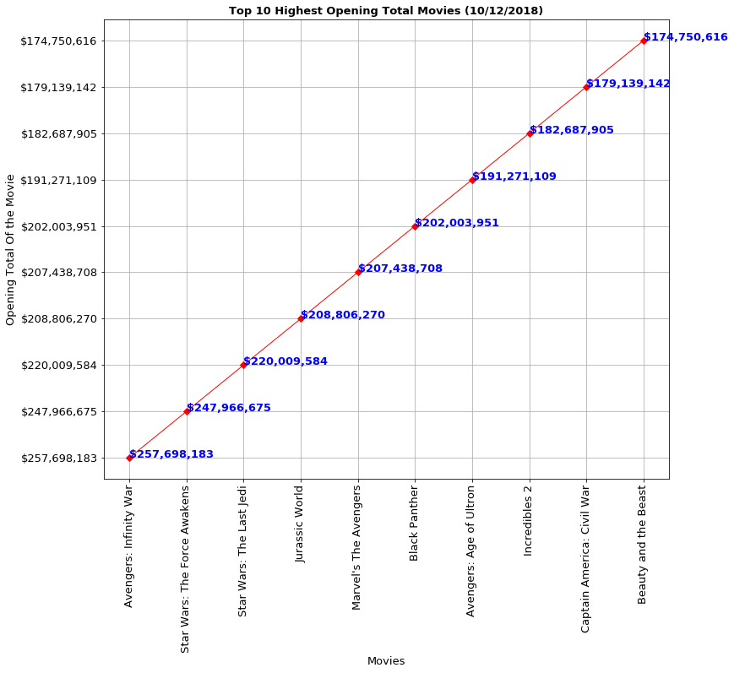
GRAPHS
MOJO DATASET: Graph 3- Top 10 Highest Opening Total Movies

Slide 10
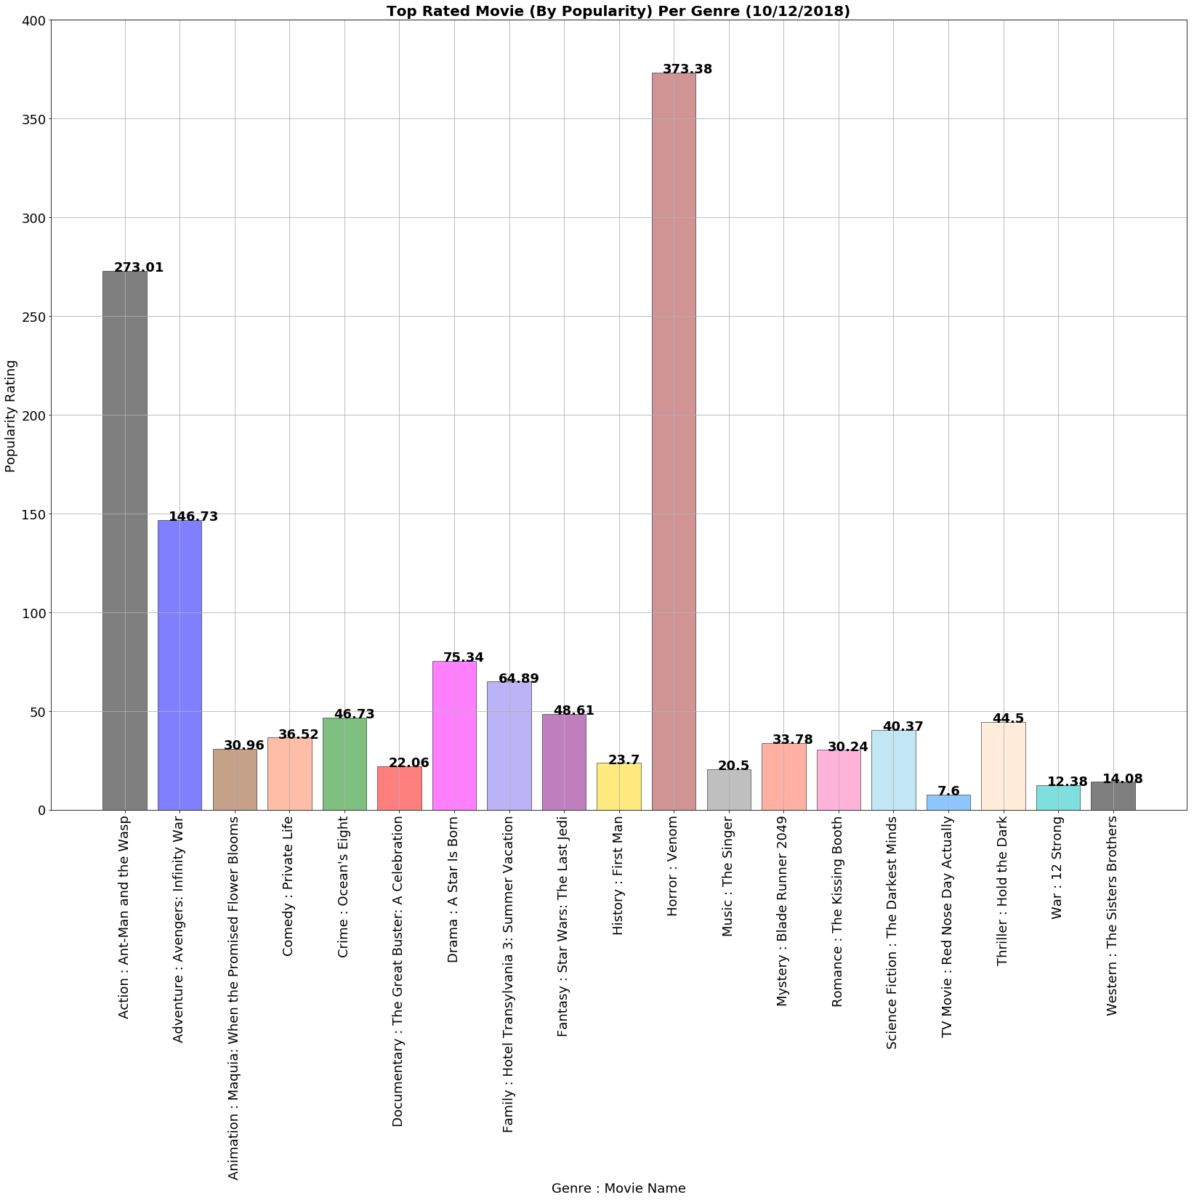
GRAPHS
TMDB DETAILS DATASET: Graph 4- Top Rated Movie (By Popularity) Per Genre

Slide 11
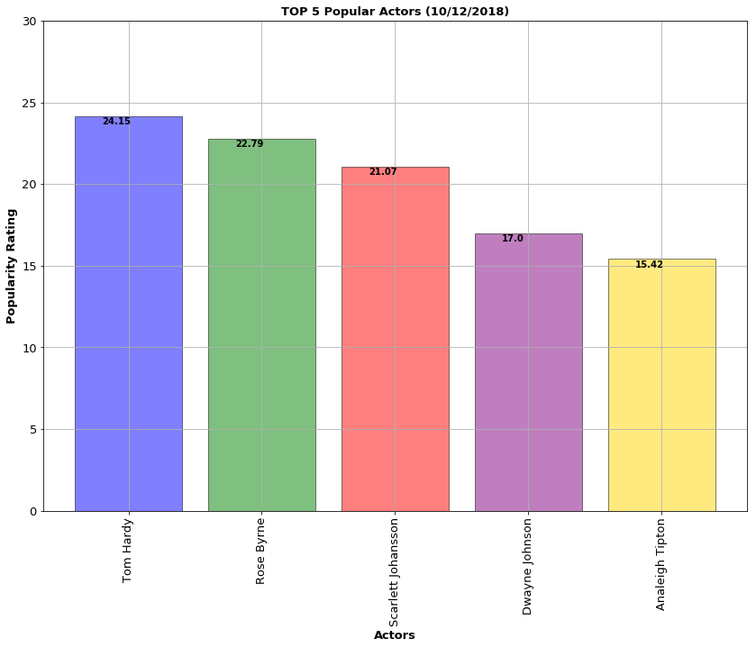
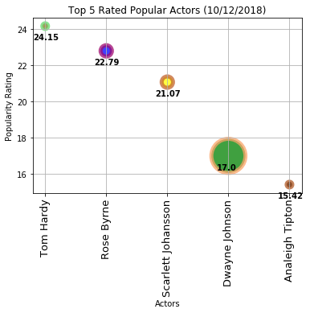
GRAPHS
TMDB COMBINED DATASET: Graph 5 - Top 5 Popular Actors

Slide 12
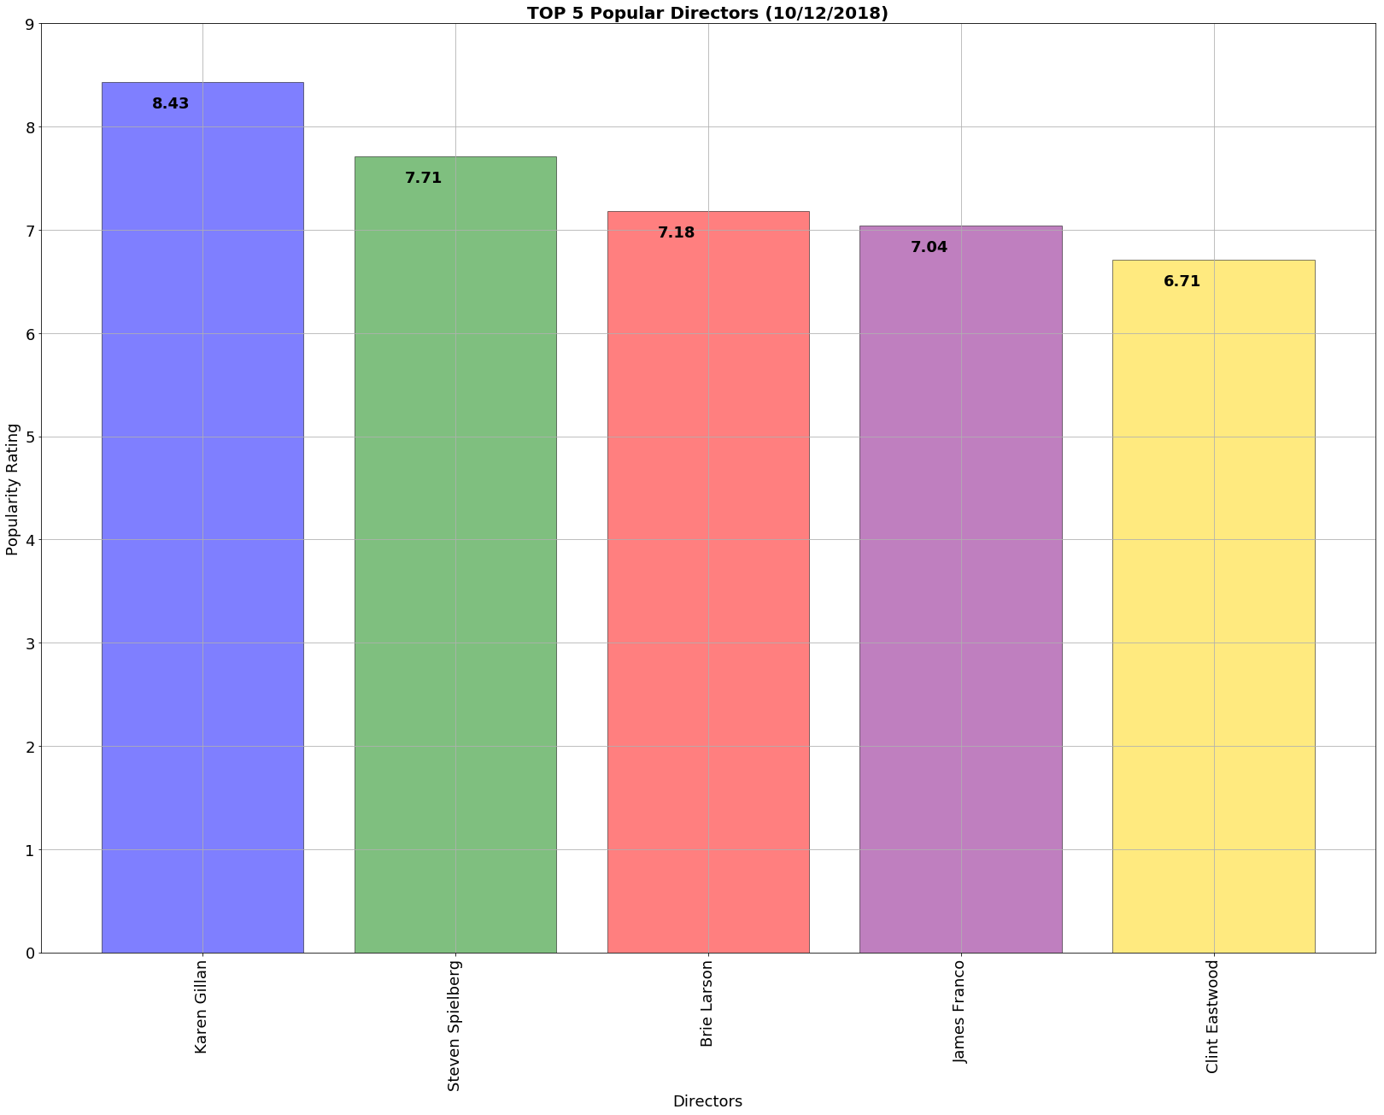
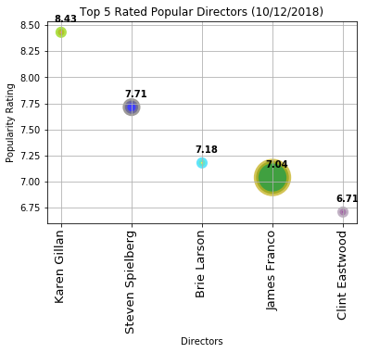
GRAPHS
TMDB COMBINED DATASET: Graph 6- Top 5 Popular Directors

Slide 13
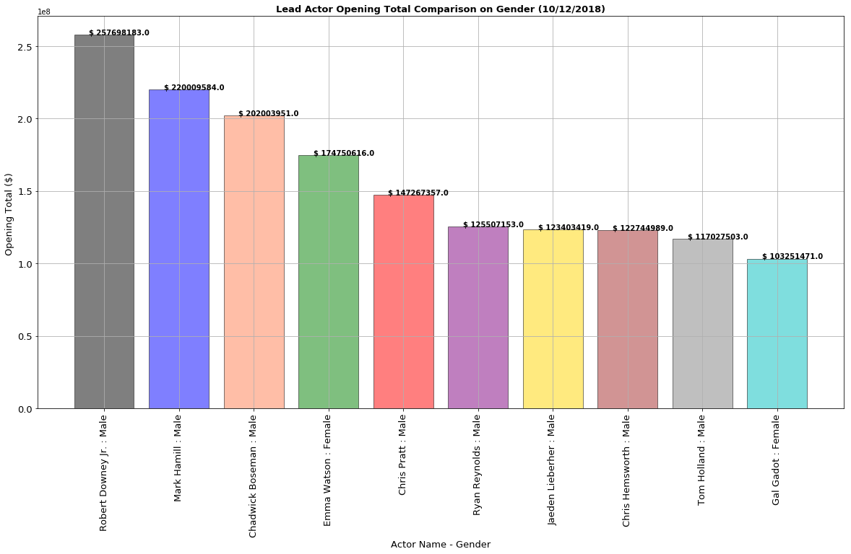
GRAPHS
MOVIE COMPLETE (MOJO + TMDB)DATASET : Graph 7 – Lead Actor Opening Total Comparison on Gender

Slide 14
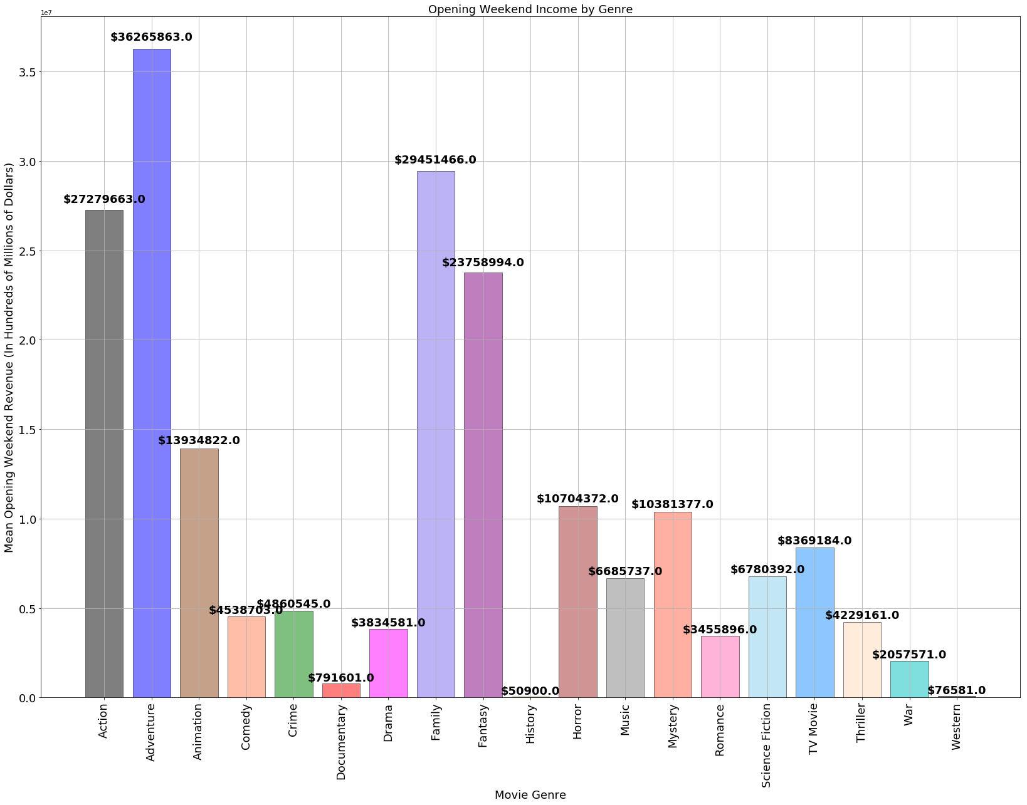
Opening Weekend Income by Genre

Slide 15
Conclusion
In the past two years, the most popular genre was action, and action/adventure movies earn the greatest revenue on opening weekend.
The most popular actor was Robert Downey Jr, and the most popular actress was Emma Watson.
The most popular directors were Karen Gillan and Steven Spielberg. Karen Gillan is rated highly within our dataset, but her rating is also affected by her successful acting career.
Prediction: An action movie featuring Robert Downey Jr, and Emma Watson, directed by Steven Spielberg, would be very successful

